Slide 1

Gendered policy outcomes? Examine family policy effects in OECD countries
Xiao Sun
Apr. 27, 2022

Slide 2
Background
Economic sanction has emerged as a popular alternative to military confrontation
Policymakers and scholars often focus on aggregate impacts on states rather than on vulnerable groups and individuals.
They often assume policy tools are gender-neutral, and so ignore the negative consequences on women.

Slide 3
Literature review
Economic sanction
Goal: a state employs economic sanctions undermines the aggregate economic might of a target state through trade and financial restrictions to coerce the targeted government to alter its political behaviors (Pape 1997 93).
Tools: tariff increases, import duties, asset freezes, expropriation, license denial, trade blacklist, aid suspension, etc. (Baldwin 1985, 41).
Gendered institution
seemingly neutral institutional processes and practices are embedded in hidden norms and values, privileging certain groups over others (Kenny 2007, 95).
state institutions are historically the products of the "mobilization of masculine bias” (Burton 1991)

Slide 4
Research design
Model
ordered logit model
Scope
146 targeted countries from 1970 to 2004; unit: country-year
Data
Drury and Peksen﻿ (2014) and ﻿Hufbauer et al. (2007) sanction data, Cingranelli–Richards (CIRI) Human Rights Database, V-Dem, PRIO Armed Conflict Database, etc.
Hypotheses
H 1: Economic sanctions will undermine women's economic rights, but the negative impact will be mitigated by gender equality in the targeted countries.
H 2: Economic sanctions will undermine women's social rights, but the negative impact will be mitigated by gender equality in the targeted countries.
H 3: Economic sanctions will undermine women's political rights, but the negative impact will be mitigated by gender equality in the targeted countries.

Slide 5
Research design
DVs
CIRI women's economic rights,
political rights
social rights (ordinal: 0, 1, 2, and 3).
IVs
economic sanction (dummy)
humanitarian sanction (dummy)
sanction duration
sanction cost
gender equality in political institutions (interval 0-4)
Control
civil war and interstate war, peace years,
GDP per capita, trade
democracy

Slide 6
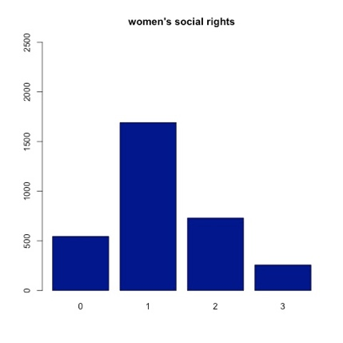
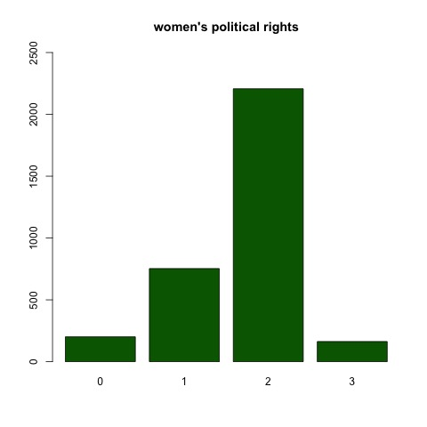
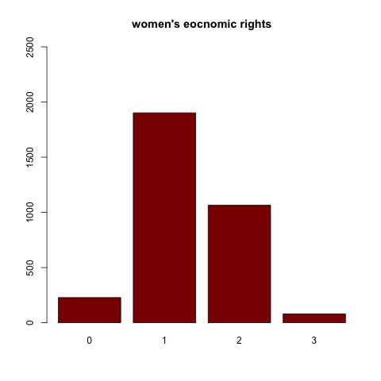
Data exploration

Slide 7
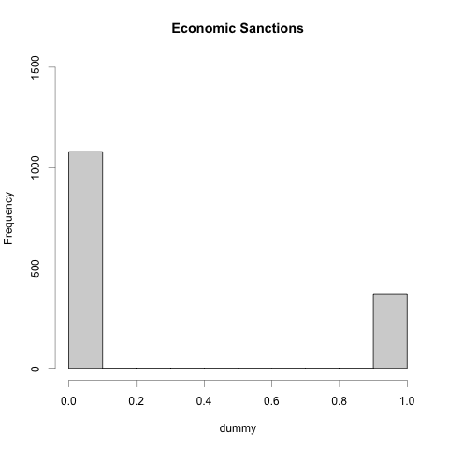
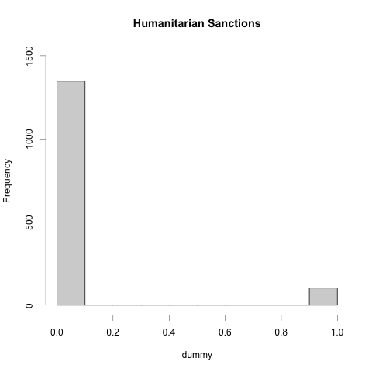
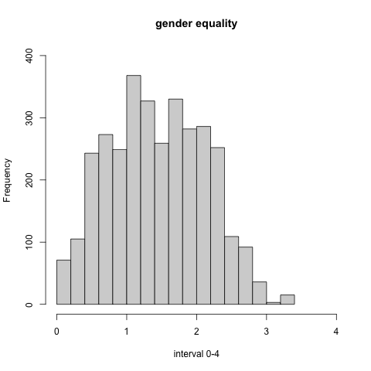
Data exploration

Slide 8
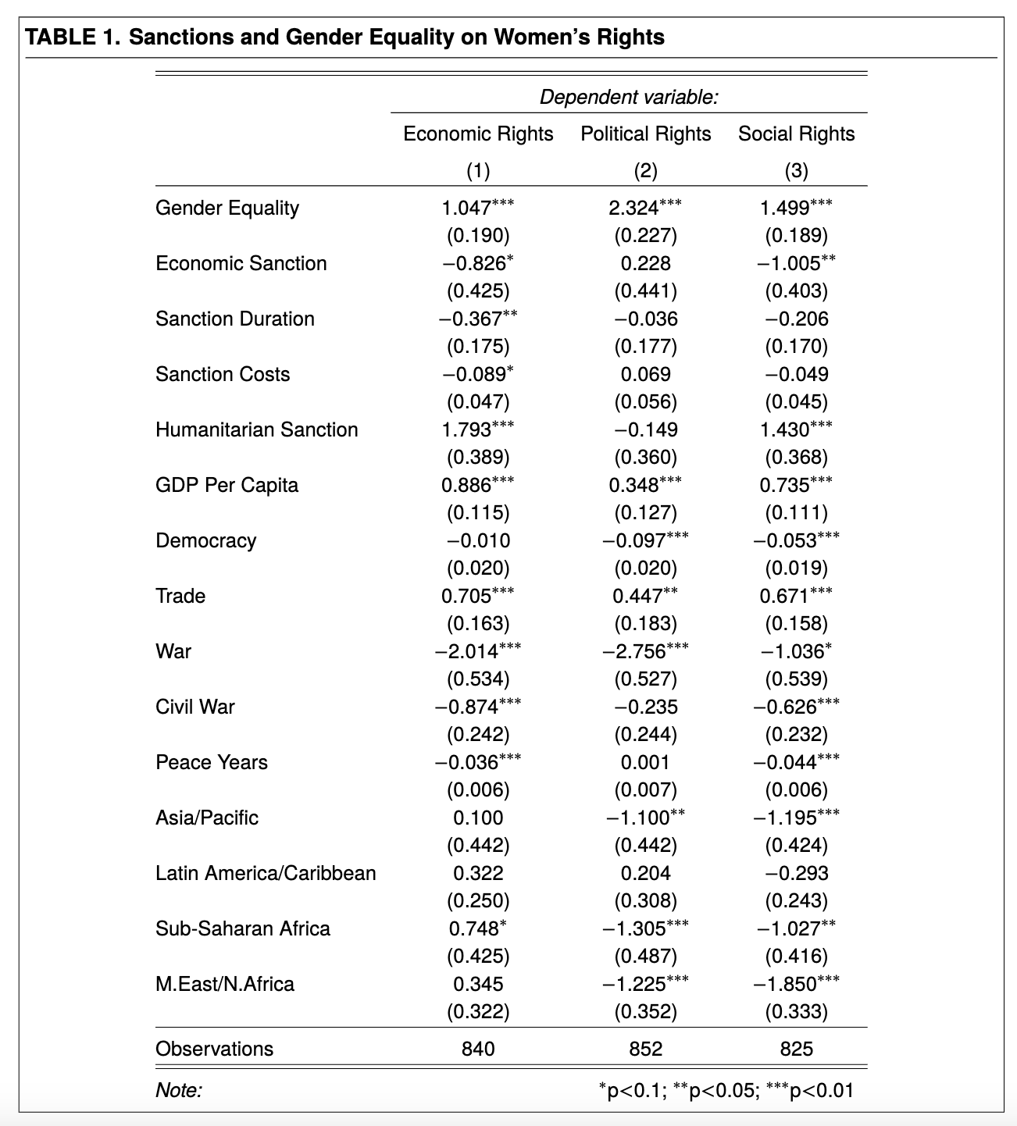
Results & Analysis

Slide 9
Limitation
Lack intersectionality (religion, race, ethnicity, class)
Gender equality might not capture the effects of gender hierarchy
Women’s rights variables cannot represent gendered effects.
Use other proxies, such as female and male labor force participation rate and unemployment rate, education enrollment, etc.

